Slide 1
SEN152 – Topic 2: The SDLC, methodologies and software development platforms and tools
2.1 The System Development Life Cycle (SDLC)
2.2 The Waterfall model
2.3 Agile methodologies
2.4 Software development platforms and tools

Slide 2
Module Outcomes
Demonstrate insight in the history of software development.
Demonstrate an understanding of different options for software development life cycles related to software design and development, and key terms, facts, principles and rules of software development.
Apply methods, tools and modelling techniques commonly employed during the various phases of software development.
Demonstrate an understanding of the importance of software maintenance and documentation.
Identify modern software development and management platforms, tools, and services, and outline the nature of the support provided.
Demonstrate an understanding of the notion of quality in software and how a Quality Management System can provide the required organisational framework.

Slide 3
(2) Introduction
In this topic, you will gain knowledge in the following areas:
2.1 The System Development Life Cycle (SDLC)
2.2 The Waterfall model
2.3 Agile methodologies
2.4 Software development platforms and tools

Slide 4

(2.1) The System Development Life Cycle (SDLC)
Systems analysts utilise the SDLC, a structured process, to create systems.
This process progresses through series of stages, resulting in a high-quality, efficient information system.
SDLC methodology is applied to enhance the existing system or implement a new one.

Slide 5
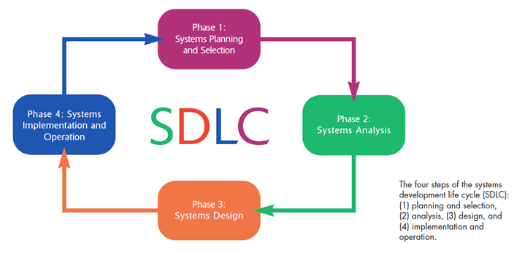
(2.1) The System Development Life Cycle (SDLC)
Figure 1 – The SDLC (Valacich, George & Hoffer, 2015:39)

Slide 6
(2.1) The System Development Life Cycle (SDLC)
Stage 1: System planning and selection
The information systems department receives numerous system requests as individuals and departments recognize the need for new or improved systems.
Stage 2: System Analysis
In this phase, the systems analyst examines the existing system to understand the issues the new system should address.

Slide 7
(2.1) The System Development Life Cycle (SDLC)
Stage 3: System Design
Systems design translates requirements into a detailed blueprint for development.
Stage 4: System Implementation and Operation
The system is developed and coded based on the design specifications.

Slide 8

(2.1) The System Development Life Cycle (SDLC)
Traditional methodologies, such as the Waterfall model
Sequential development refers to a method where each phase flows into the next, and a phase cannot begin until the previous one is completed.

Slide 9
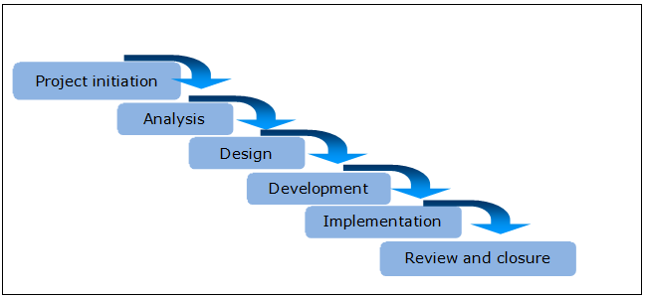
(2.2) The Waterfall model
There are many variations
Typically consists of 6 phases

Slide 10
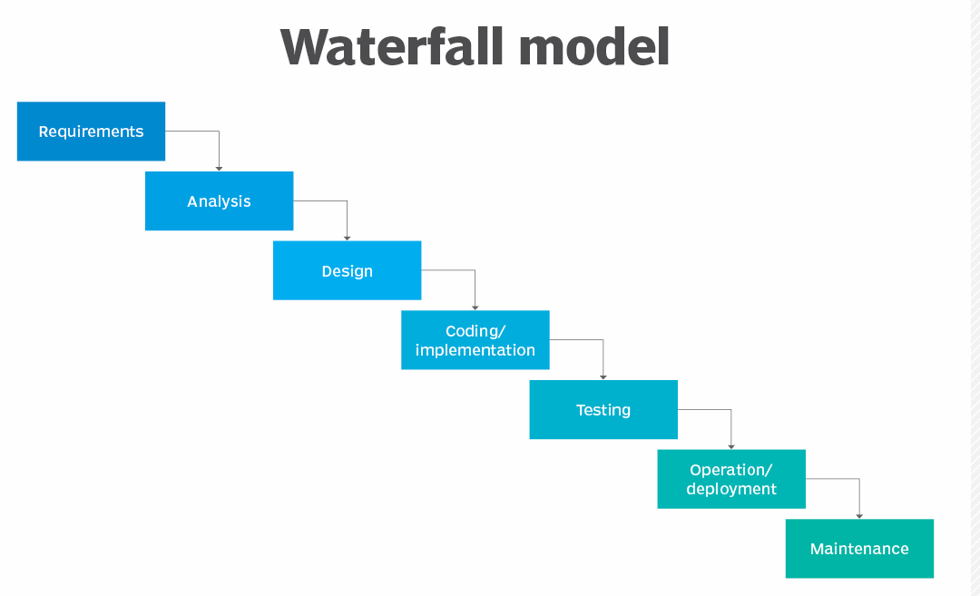
(2.2) The Waterfall model
Figure 3 – The Waterfall model (Awati & Gillis, 2024)

Slide 11
(2.2) The Waterfall model
Each completed phase in the Waterfall model results in a tangible product or deliverable, which serves as a milestone to assess the likelihood of a successful outcome.
The next phase cannot begin until the previous one has been successfully completed.
This model is ideal when the requirements are clearly defined and stable, when structure and control are necessary during the development process, and when comprehensive system documentation is crucial.

Slide 12
(2.2) The Waterfall model
The Waterfall model is best suited for situations where (Atlassian, 2025):
Requirements are well-defined and unlikely to change
The product definition is stable
The technology is well-understood
A new version of an existing product is being developed
Porting an existing product to a new platform

Slide 13
(2.2) The Waterfall model
While the Waterfall model is simple and effective, it has shown to be highly inflexible.
Many systems follow a sequential process, making the Waterfall model a natural fit for such projects.

Slide 14

(2.3) Agile methodologies
2.3.1 Agile Alliance
Agile software development emerged in response to the limitations of traditional methodologies.
In the late 1990s, there was a growing need for more flexible methodologies that could better handle changing requirements.
In 2001, the Agile Manifesto was created by a group of programming methodology experts who formed the Agile Alliance.

Slide 15
(2.3) Agile methodologies
2.3.1 Agile Alliance
The manifesto outlines four core values, stating that "while there is value in the items on the right, we value the items on the left more" (Agile Alliance, 2025):
Individuals and interactions over processes and tools
Working software over comprehensive documentation
Customer collaboration over contract negotiation
Responding to change over following a plan

Slide 16

(2.3) Agile methodologies
2.3.2 Prototyping
An iterative process
Creating a scaled-down version of a system that is analysed, designed, developed, and tested
Allows for early user feedback - incorporated into each new iteration
Developers make improvements as soon as they are identified
Ensuring a high-quality end-product

Slide 17
(2.3) Agile methodologies
2.3.2 Prototyping
Benefits
It encourages and requires active end user participation.
It involves iteration and accommodates change.
It endorses the philosophy that end users will not know what they want until they see it.
Prototypes are active models that end users can experience with their senses.
Errors can be detected much earlier.
It can lead to better solutions and increase creativity, as prototyping allows for rapid user feedback.

Slide 18
(2.3) Agile methodologies
2.3.2 Prototyping
Drawbacks
It encourages a focus on a cycle of coding, implementation and repair.
It does not eliminate the systems analysis phase.
It does not address all design issues, some of which can be forgotten.
It often leads to premature commitment to a specific design.
During prototyping, systems scope and complexity can rapidly increase beyond the original plan.
It can reduce design creativity.

Slide 19

(2.3) Agile methodologies
2.3.2 Prototyping
Among the various mobile application prototyping tools available today, Axure stands out.
Axure's capabilities include interactive prototyping that enhances visualisation, facilitates efficient iteration, and supports user testing and feedback collection.
Axure promotes collaboration among teams by allowing real-time feedback and tracking changes.

Slide 20
(2.3) Agile methodologies
2.3.3 JAD (Joint Application Development)
JAD is a structured process where users, managers, and systems analysts collaborate in a series of intensive meetings over a few days to review system requirements.

Slide 21
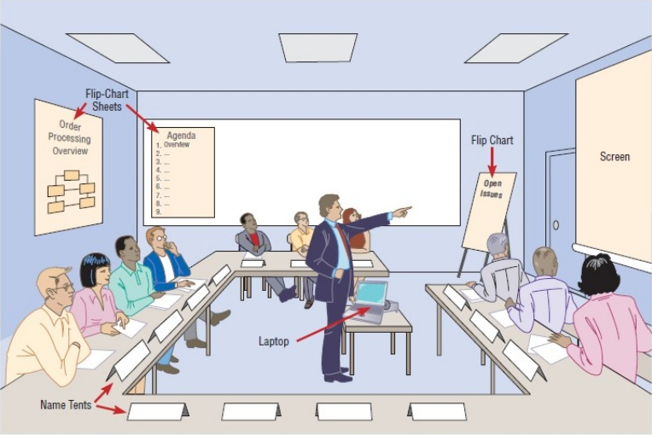
(2.3) Agile methodologies
Figure 4 – JAD session: typical room layout (Valacich, et al., 2015:166)

Slide 22
(2.3) Agile methodologies
2.3.4 RAD (Rapid Application Development)
RAD emerged as a response to the structured methodologies developed in the 1970s and 1980s.
Deliver software rapidly while adapting to changing requirements.
Emphasizes continuous user involvement through prototyping, which allows for gathering user feedback.
Increases the likelihood of meeting customer requirements.
The phases are iterative and repeated many times by the development team until the end- product satisfies the user requirements.

Slide 23
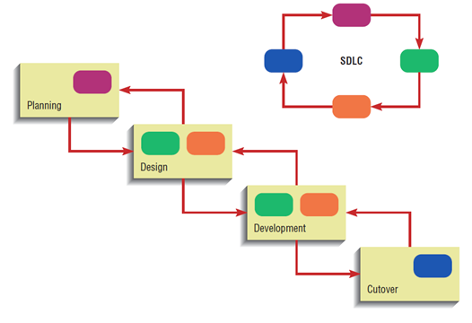
(2.3) Agile methodologies
Figure 5 – RAD compared to standard SDLC (Valacich, et al., 2015:46)

Slide 24
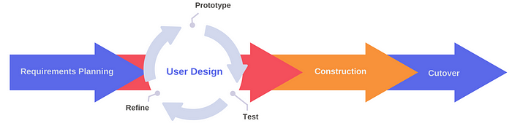
(2.3) Agile methodologies
Figure 6 – The phases of RAD (Lomio & Mejidana, 2023)

Slide 25
(2.3) Agile methodologies
2.3.4 RAD (Rapid Application Development)
Barry Boehm, a software engineer, developed the first RAD alternative, known as the "spiral model" in 1986.
The spiral model emphasizes the importance of risk analysis in every phase of systems development.
Risk is evaluated and addressed each time the process reaches the risk analysis step.

Slide 26
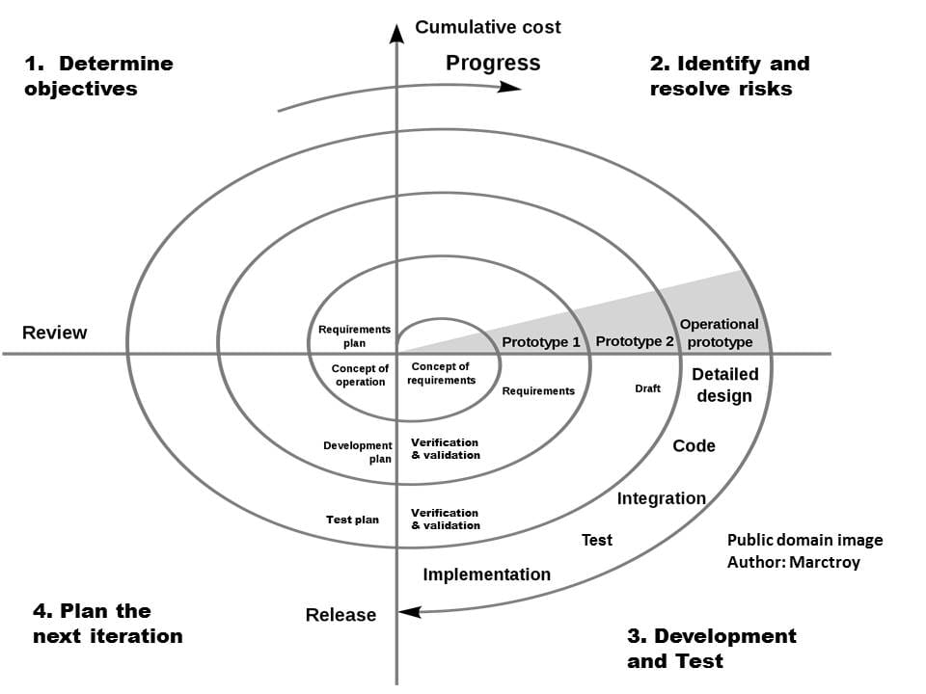
(2.3) Agile methodologies
Figure 7 – The Spiral model (Victor, 2025)

Slide 27
(2.3) Agile methodologies
2.3.5 eXtreme programming (XP)
XP, developed by Kent Beck, is a prominent agile methodology recognized for enhancing software quality and accommodating changing requirements.
The term "extreme" reflects the methodology's emphasis on pushing iterative development to its limits.
Teams aim to deliver functional software versions frequently, sometimes multiple times a day.

Slide 28
(2.3) Agile methodologies
2.3.5 eXtreme programming (XP)
In XP, increments of software are delivered to customers bi-weekly, with testing conducted after each release.
Upon customer acceptance and successful testing, team members finalize the version.
This methodology is best suited for experienced developers.
It requires full-time customer involvement, treating them as integral team members.

Slide 29

(2.3) Agile methodologies
2.3.5 eXtreme programming (XP)
A key practice in XP is pair programming, where two developers collaborate closely, reviewing each other's code and occasionally switching roles.
XP encourages continuous refactoring of code until both the customer and the team are satisfied with the product iterations.

Slide 30
(2.3) Agile methodologies
2.3.5 eXtreme programming (XP)
Drawbacks
For scope creep—where project scope expands uncontrollably without managing cost, time, and quality constraints.
Can also be ineffective if not implemented by a skilled team and may lack the structure and documentation typical of traditional methodologies.
Systems design may not receive as much attention as in conventional approaches

Slide 31
(2.3) Agile methodologies
There are many other agile methodologies, such as:
Kanban
Crystal
Dynamic Systems Development Method (DSDM)
SCRUM

Slide 32
2.3) Agile methodologies
Study the following link: https://www.scrum.org/. In small groups, conduct research on SCRUM (an agile methodology), and describe the SCRUM terms below: -Scrum master -Daily scrum meeting -Product backlog -Sprint backlog -Burndown chart | Website duration: 10:00 (estimated)
Discuss SCRUM with your fellow students and lecturer.

Slide 33

(2.4) Software development platforms and tools
A software platform serves as a foundational environment that enables developers and users to create, run, and manage applications.
A software tool is a specific application or program designed to perform a particular task.

Slide 34
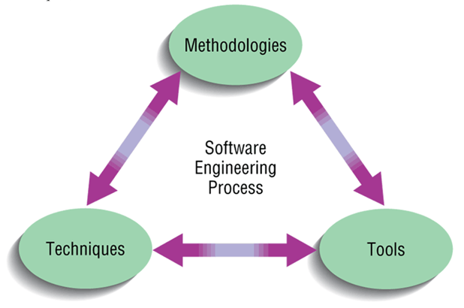
(2.4) Software development platforms and tools
Figure 8 – The software engineering process (Valacich et al., 2015:31).

Slide 35
(2.4) Software development platforms and tools
System professionals play an important role in the software engineering process by ensuring a strong understanding of methodologies, techniques, and tools.
A technique refers to a particular method for performing a task to reach a specific goal.
A tool is an instrument or computer program utilised to implement the technique.
A methodology serves as a structured framework that encompasses various stages, guiding the process toward achieving a comprehensive outcome.

Slide 36

(2.4) Software development platforms and tools
Example:
In the construction industry, designing the foundation of a new building requires a specific technique.
Architects and designers utilize specialised software as the tool to facilitate this design process.
Additionally, team will implement a methodology or framework commonly used in foundation engineering to ensure a systematic approach toward achieving a successful outcome.

Slide 37
(2.4) Software development platforms and tools
Integrated Development Environments (IDEs) and Code Editors:
Visual Studio Code (VS Code): A widely used, flexible, and free IDE that supports multiple languages and platforms. It has a fast source code editor, perfect for day-to-day use.
NetBeans: A free, open-source IDE used for developing desktop, mobile, and web applications.

Slide 38
(2.4) Software development platforms and tools
Version Control Systems:
GitHub: A leading web-based platform for hosting code repositories, enabling developers to collaborate, manage projects, and review code. It uses Git - a version control system.
Bitbucket: Atlassian owns Bitbucket. It is a Git-based source code repository hosting service for software developers.

Slide 39
(2.4) Software development platforms and tools
Project Management and Collaboration Tools:
Jira: A project management tool to track issues, automate workflows and manage general project management tasks.
Slack: A cloud-based, AI-powered messaging platform for project teams to support team communication and collaboration.

Slide 40
(2.4) Software development platforms and tools
Cloud Platforms:
Amazon Web Services (AWS): A cloud platform providing IT resources on demand and on a pay-as-you-go basis. It offers computing, storage and database capabilities.
Microsoft Azure: A cloud platform offering computational, networking, storage, analytics and AI capabilities, for organisations to manage a range of applications.

Slide 41
(2.4) Software development platforms and tools
More categories
Testing and quality assurance tools
Database management tools
Containerisation and orchestration tools
Build automation tools

Slide 42
(2.4) Software development platforms and tools
Computer Aided Software Engineering (CASE) tools:
Automated software tools that systems professionals use to develop information systems (tools for different development stages):
Diagramming tools
Analysis tools
Computer display and report generators
Repository
Code generators
Documentation generators

Slide 43
(2.4) Software development platforms and tools
Diagramming tools:
IBM System Architect
Lucidchart
Miro
Microsoft Visio
SmartDraw
…and many more.

Slide 44
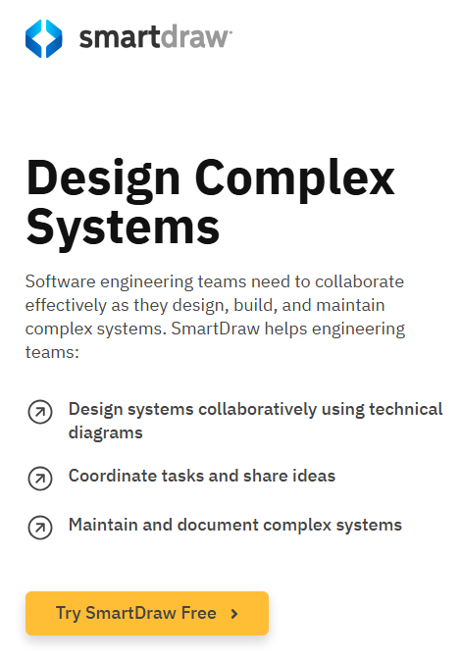
(2.4) Software development platforms and tools
Figure 9 – SmartDraw for software engineering (Smartdraw, 2025).

Slide 45
(2.4) Software development platforms and tools
Study the functionality of LucidChart (https://www.lucidchart.com/pages). | Website duration: 06:00 (estimated)
Discuss the functionality of this diagramming tool with your lecturer and fellow students.

Slide 46

(2.4) Software development platforms and tools
Artificial Intelligence (AI)-powered software development assistants supporting code generation:
Qodo Gen
Cursor AI
Codeium
AskCodi
There are many AI code generators on the market.

Slide 47
(2.4) Software development platforms and tools
Study the following link: https://whatfix.com/blog/software-documentation-tools/. | Website duration: 06:00 (estimated)
In small groups, conduct research on Software documentation tools. Discuss these tools with your fellow students and lecturer.

